Slide 1

Node JS Intro
Lecturers: Gjorge Dimitrov & Borche Borisovski

Slide 2


Difference between frontend and backend development
* What we've learned?

Slide 3
Difference between frontend and backend development
Front-end
Frontend refers to the client-side of an application
It is the part of a web application that users can see and interact with
It typically includes everything that attributes to the visual aspects of a web application
HTML, CSS, JavaScript, Angular, and ReactJS are some of the essentials of frontend development

Slide 4
Difference between frontend and backend development
Back-end
Backend refers to the server-side of an application
It constitutes everything that happens behind the scenes
It generally includes a web server that communicates with a database to serve requests
Java, C#, Python, and Node.js are some of the backend development technologies

Slide 5
History of Node.js
2009
Node.js is born
The first form of npm is created
2010
Express is born
Socket.io is born
2011
npm hits version 1.0
Larger companies start adopting Node.js: LinkedIn, Uber, etc.
hapi is born
2012
Adoption continues very rapidly

Slide 6
History of Node.js
2013
First big blogging platform using Node.js: Ghost
Koa is born
2014
The Big Fork: io.js is a major fork of Node.js, with the goal of introducing ES6 support and moving faster
2015
The Node.js Foundation is born
IO.js is merged back into Node.js
npm introduces private modules
Node.js 4 (versions 1, 2 and 3 never previously released)
2016
The leftpad incident
Yarn is born
Node.js 6

Slide 7
History of Node.js
2017
npm focuses more on security
Node.js 8
HTTP/2
V8 introduces Node.js in its testing suite, officially making Node.js a target for the JS engine, in addition to Chrome
3 billion npm downloads every week
2018
Node.js 10
ES modules .mjs experimental support
Node.js 11
2019
Node.js 12
Node.js 13
2020
Node.js 14
Node.js 15

Slide 8
What is Node.js?
Node.js is an open-source, cross-platform, JavaScript runtime environment which runs web applications outside the client’s browser. It is used to create server-side web applications.

Slide 9
Where can you use it?
Node.js is perfect for data-intensive applications as it uses an asynchronous, event-driven model. You can use I/O intensive web applications like video streaming sites. You can also use it for developing: Real-time web applications, Network applications, General-purpose applications, and Distributed systems.

Slide 10
Why use Node.js?
Node.js makes building scalable network programs easy. Some of its advantages include:
It is generally fast
It rarely blocks
It offers a unified programming language and data type
Everything is asynchronous
It yields great concurrency

Slide 11
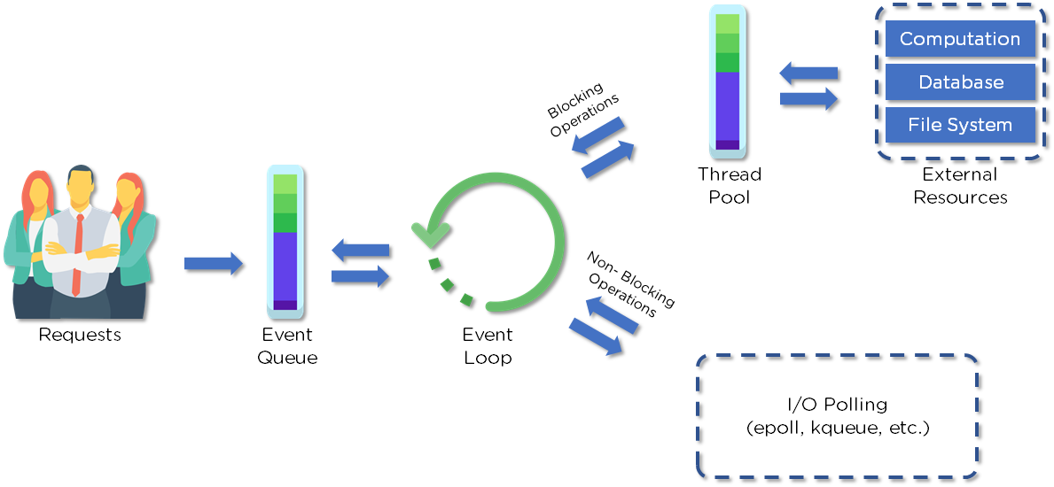
How does Node.js work?

Slide 12
How does Node.js work?
Clients send requests to the webserver to interact with the web application. Requests can be non-blocking or blocking:
Querying for data
Deleting data
Updating the data
Node.js retrieves the incoming requests and adds those to the Event Queue
The requests are then passed one-by-one through the Event Loop. It checks if the requests are simple enough not to require any external resources
The Event Loop processes simple requests (non-blocking operations), such as I/O Polling, and returns the responses to the corresponding clients
A single thread from the Thread Pool is assigned to a single complex request. This thread is responsible for completing a particular blocking request by accessing external resources, such as computation, database, file system, etc.
Once the task is carried out completely, the response is sent to the Event Loop that sends that response back to the client.

Slide 13
Why is Node.js Single-threaded?
Node.js is single-threaded for async processing. By doing async processing on a single-thread under typical web loads, more performance and scalability can be achieved instead of the typical thread-based implementation.

Slide 14
How would you define the term I/O?
The term I/O is used to describe any program, operation, or device that transfers data to or from a medium and to or from another medium
Every transfer is an output from one medium and an input into another. The medium can be a physical device, network, or files within a system

Slide 15
How is Node.js most frequently used?
Real-time chats
Internet of Things
Complex SPAs (Single-Page Applications)
Real-time collaboration tools
Streaming applications
Microservices architecture

Slide 16
Why is Node.js preferred over other backend technologies like Java and .NET?
Node.js is very fast
Node Package Manager has over 50,000 bundles available at the developer’s disposal
Perfect for data-intensive, real-time web applications, as Node.js never waits for an API to return data
Better synchronization of code between server and client due to same code base
Easy for web developers to start using Node.js in their projects as it is a JavaScript library

Slide 17
Pros and cons of Node.js?
Pros | Cons
Fast processing and an event-based model | Not suitable for heavy computational tasks
Uses JavaScript, which is well-known amongst developers | Using callback is complex since you end up with several nested callbacks
Node Package Manager has over 50,000 packages that provide the functionality to an application | Dealing with relational databases is not as “natural” as in other environments/frameworks
Best suited for streaming huge amounts of data and I/O intensive operations | Since Node.js is single-threaded, CPU intensive tasks are not its strong suit

Slide 18
Who is using Node.js?

